Slide 1

DR.KEDAR NATH MODI INSTITUTE OF
ENGINEERING AND TECHNOLOGY
PROJECT PROPOSAL
CREATED BY :- Smriti Kumari
AF04991239
D-2406
ITPR
GUIDED BY:-
Mr. Anuj Kumar

Slide 2

TITLE OF THE PROJECT AIRLINE MANAGEMENT SYSTEM

Slide 3

introduction
The Airline Management System is a software application designed to simplify and automate the operations of an airline. In the modern aviation industry, managing flight schedules, passenger information, bookings, staff, and payments manually is time-consuming and prone to errors. To overcome these challenges, this project provides a digital solution that ensures accuracy, efficiency, and smooth functioning of airline activities.
This system allows administrators to manage flights, airplanes, and staff, while passengers can easily search for flights, book tickets, and view their booking details. The system also supports essential features such as ticket cancellation, seat availability checking, and secure data storage. By using Java for application development and MySQL as the backend database, the project ensures reliability, scalability, and robust performance.
Overall, the Airline Management System helps streamline airline operations, reduces paperwork, improves customer experience, and maintains all airline-related records in an organized manner. It is a practical and efficient solution for real-world airline management needs.

Slide 4
PROBLEM STATEMENT
What are today’s Problem Statement ?
Airlines deal with large volumes of data: flights, passengers, bookings, and staff. Managing these manually leads to issues such as data duplication, delays, lost records, and poor customer service. There is a need for a digital system that can handle these operations efficiently in real-time.

Slide 5
OBJECTIVE
:-To automate airline operations and reduce manual workload
:-To manage flights, passengers, tickets, and staff in a single system.
:-To provide an easy interface for booking and canceling tickets.
:-To maintain accurate and secure databases.
:-To generate reports for decision-making.
:-To improve customer satisfaction through faster services
TABLE :-PASSENGER

Slide 6
Project category
Database Management System:- As the project involves creating tables , managing records, queries and connectivity with Java + SQL.
Application Software:- The most used technologies used here are:
SQL(Structured Query Language),
JDBC(Java Database connectivity)
JAVA
OOP(Object Oriented Programming as the project uses modules and DAO,ETC

Slide 7
ANALYSIS MODULES AND DESCRIPTION:-
AUTHENTICATION MODULE:-
Handles login functionality for Admin and User .It consists of Admin login, User login and Password protection.
FLIGHT MANAGEMENT MODULE:-
Handles all operations related to flights such as Add/ Update existing flight details/ Remove a flight/ View all flight/Search flight by source and destination.
PASSENGER MANAGEMENT MODULE:-
This manages passenger information. Add Passenger Detail(name , age, gender, contact)/Modify/View/Retrieve passenger by ID.

Slide 8
BOOKING MANAGEMENT MODULE:-
Handles the complete flight ticket booking lifecycle. Search available fight/Book ticket/ Generate Booking Id/Update Available seats /Provide Booking confirmation.
SEARCH MODULE:-
Provides an interface for users to search for users to search flight based on parameters. Search by destination and origin/Search by date/Display capacity.
PAYMENT MODULE:-
Handles online payments for booking. Payment gateway/Biling ad Invoice Generation.
CANCELLATION MODULE:-
Allows Passenger or admin to cancel existing booking. Retrieve Booking Details/Cancel Ticket/Update available seats /Mark booking as CANCELLED.

Slide 9
DATABASE DESIGN:-
TABLE : FLIGHT
FIELD | DATA TYPE | DESCRIPTION
Flight id Flight name | INT PRIMARY KEY VARCHAR(50) | Unique id Flight name
Origin | VARCHAR(50) | Departure City
Destination Arrival Time | VARCHAR(50) DATETIME | Arrival City Arrival Date &Time
Destination Time | DATETIME | Dest Date & Time
Capacity Fare | INT DECIAML(10,2) | Availability Ticket Price
TABLE :-PASSENGER
FIELD | DATA TYPE | DESCRIPTION
Passenger id | INT PRIMARY KEY | Unique id
Name | VARCHAR(50) | Passenger name
Phone | VARCHAR(50) | Phone number
Email | VARCHAR(100) | Email Address

Slide 10
TABLE :- BOOKING
FIELDS | DATA TYPE | DESCRIPTION
Booking ID | INT PRIMARY KEY | Unique Booking No.
Passenger ID | INT | Passenger Who Booked
Flight ID | INT | Flight Selected
Seat NO. | VARCHAR(50) | Specifies Allotted Seat
Status | VARCHAR(20) | Booked/Cancelled
TABLE :- USER
FIELD | DATATYPE | DESCRIPTION
User ID | INT PRIMARY KEY | Unique ID
User Name | VARCHAR(50) | Login Usename
Password Role | VARCHAR(100) VARCHAR(20) | Login Password Admin/User

Slide 11
TABLE :- PAYMENT
FIELD | DATATYPE | DESCRIPTION
Payment ID | INT PRIMARY KEY | Unique Payment No.
Booking ID | INT | Booking Reference
Amount | DECIMAL(10,2) | Paid Amount
Payment Date | DATETIME | Date Of Payment
Payment Method | VARCHAR(20) | Payment Method(UPI/CARD)
TABLE :- CANCELLATION
FIELD | DATATYPE | DESCRIPTION
Cancellation ID | INT PRIMARY KEY | Cancellation No.
Booking ID | INT | Booking Ref.
Cancellation Time | DATETIME | Time Of cancellation
Refund Amount | DOUBLE(10,2) | Refunded Amount
Cancellation Status | VARCHAR(50) | Cancelled

Slide 12
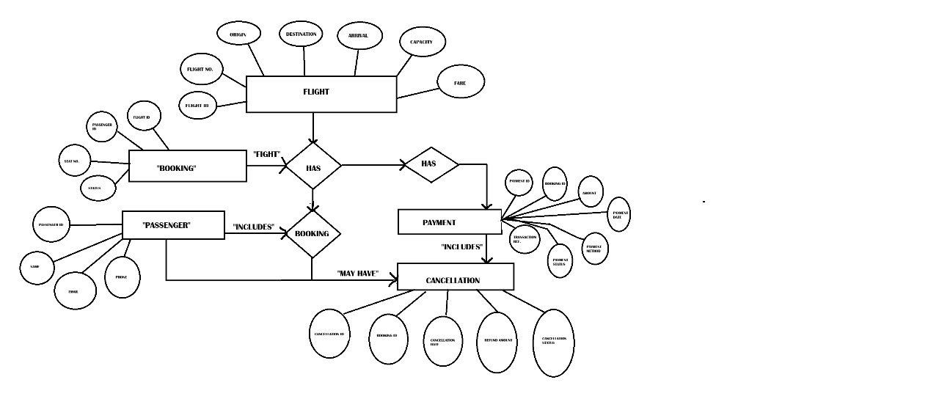
ENTITY RELATIONSHIP DIAGRAM

Slide 13
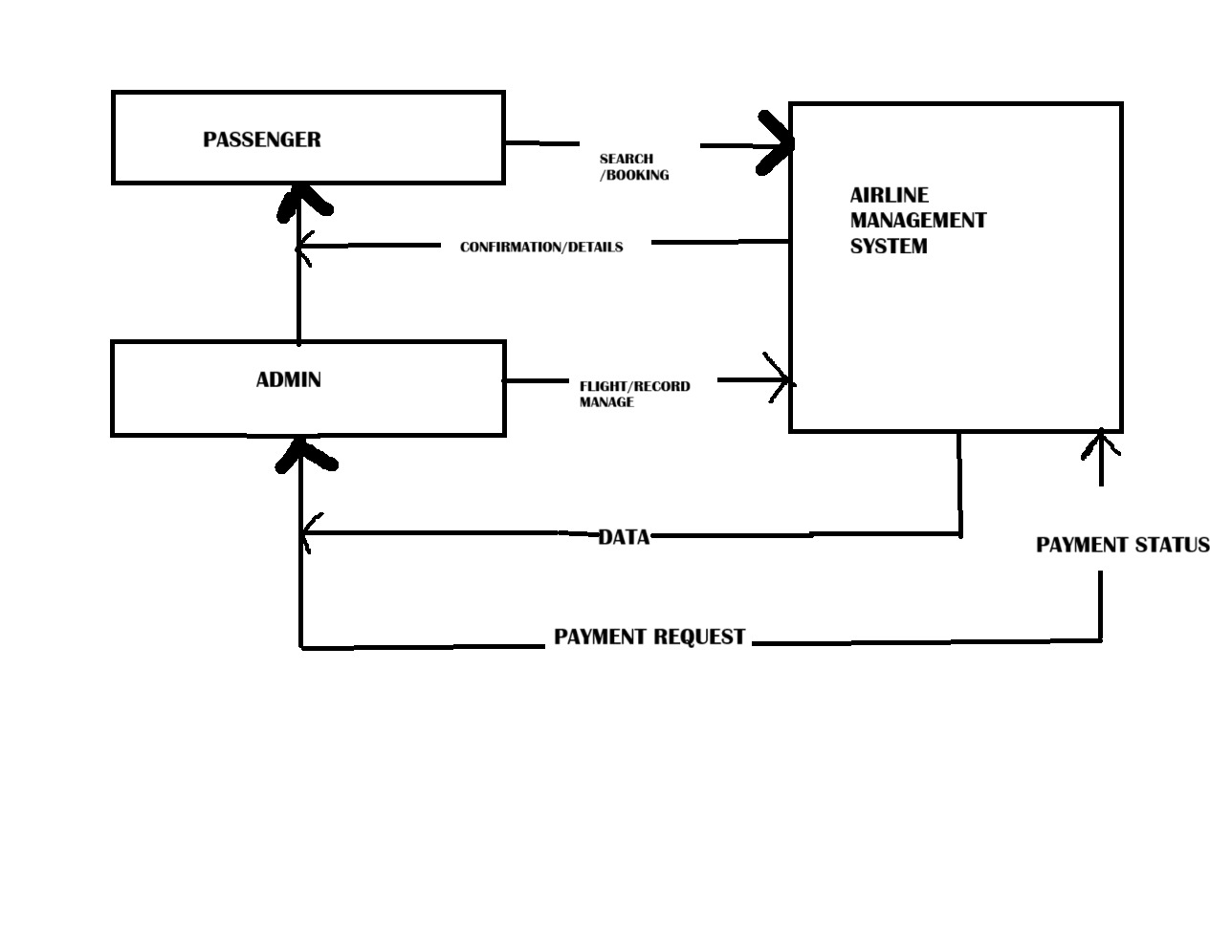
DATA FLOW DIAGRAM
ZERO LEVEL DFD

Slide 14
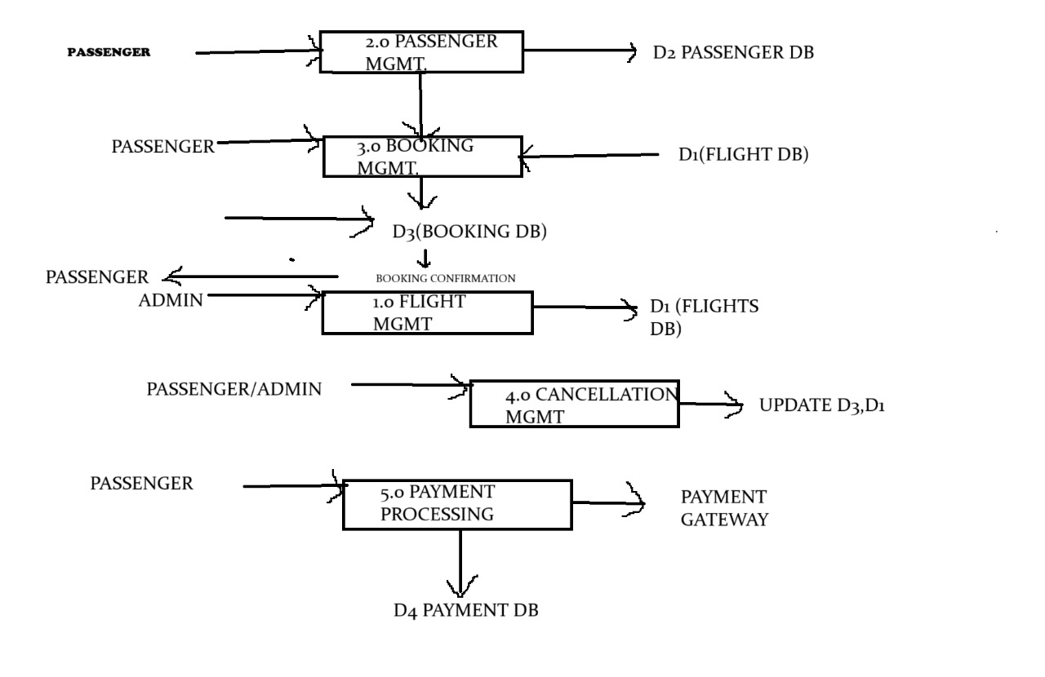
ONE LEVEL DFD

Slide 15
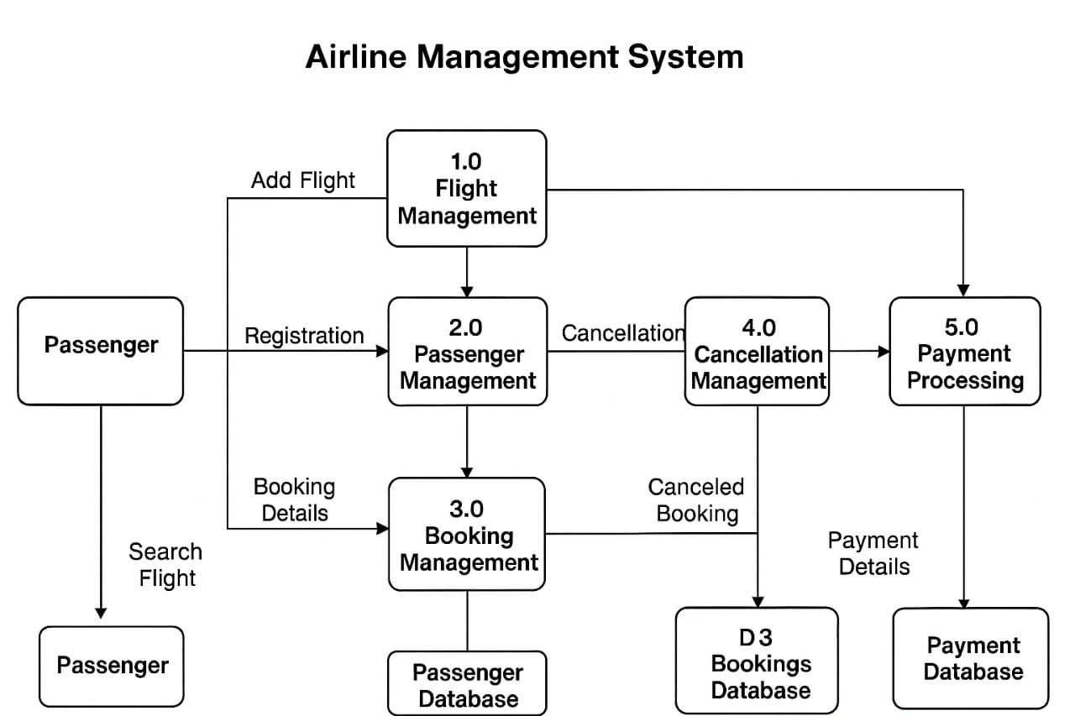
COMPLETE STRUCTURE
PROCESS LOGICAL DIAGRAM

Slide 16
PLATFORM USED
Software Requirements:
Operating System: Windows
Programming Language: Java
Tools: Maven Database: MySQL 8+IDE: IntelliJ / Eclipse
Driver :(MySQL Connector-J)
Libraries :JDBC
Hardware Requirements:
Processor: Intel i5
RAM: 16 GB
Hard Disk: 364 MB free space

Slide 17
FUTURE SCOPE
Add online ticket booking through web or mobile app.
Integrate secure payment gateways (UPI, cards, net banking).
Enable real-time flight status and tracking.
Provide mobile check-in and digital boarding passes.
Include seat selection with a graphical seat map.
Implement AI-based dynamic ticket pricing.
Add detailed analytics and reporting tools.
Deploy system on cloud for scalability and remote access

Slide 18
BIBLIOGRAPHY
Korth, Silberschatz & Sudarshan, Database System Concepts, McGraw-Hill Education.
Oracle & MySQL Official Documentation – JDBC Connectivity, SQL Queries, and Database Design.
Tutorials Point – Articles on Java Programming, JDBC, and Database Connectivity.
Geeks for Geeks – Tutorials on Java OOP Concepts, SQL, ER Diagrams, and JDBC.
Research papers and online references related to Airline Reservation Systems and Management Systems.
Herbert Schildt, Java: The Complete Reference, McGraw-Hill Education, 11th Edition.

Slide 19
THANK
YOU!!

